Slide 1
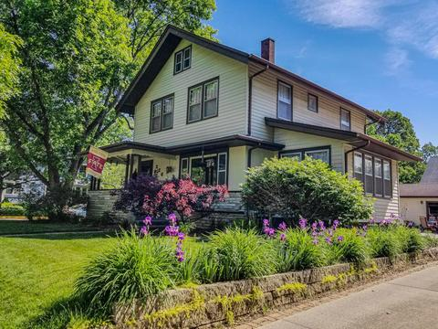

Machine Learning Models Evaluation for predicting house prices in USA
Project - Term 3: Machine Learning Foundation

Slide 2
Problem Statement
Many of us in our lifetime encounter a process of buying or selling a house. A House Buyer is interested in purchasing the best house for the money he is paying to the Seller however a House Seller is interested in selling the house for the best-selling price. This project is focused on predicting house prices in USA based on the data available. This will eventually help potential house buyers as well as sellers.
Typically when the house value is evaluated, a layman may consider features of the house such as neighborhood, vicinity to key places (such as hospitals-clinics, schools, banks, markets-malls, public transport, work location etc.), square footage of the house, house type, number of bedrooms/bathrooms, amount of space around the house, vehicle parking, number of years, utilities supply etc.
In this project We are analyzing all feature variables available in dataset and evaluate the best machine learning model for the prediction of house prices.
Notes:
A fast food restaurant which is also know as a quick service restaurant is a type of restaurant wherein fast food cuisine is served which is mostly a self served. A fast food restaurant term has come from United States of America and this EDA study is focusing on analysis the current trend of fast food restaurants in USA.

Slide 3
Project Objective
Understand the dataset of 1460 houses in Ames, Iowa, USA location by performing an EDA process and analyze all 80 variables in the dataset which are impacting the prediction of house prices (Target Variable). Use Machine Learning models for this dataset and evaluate model using model evaluation techniques.

Slide 4
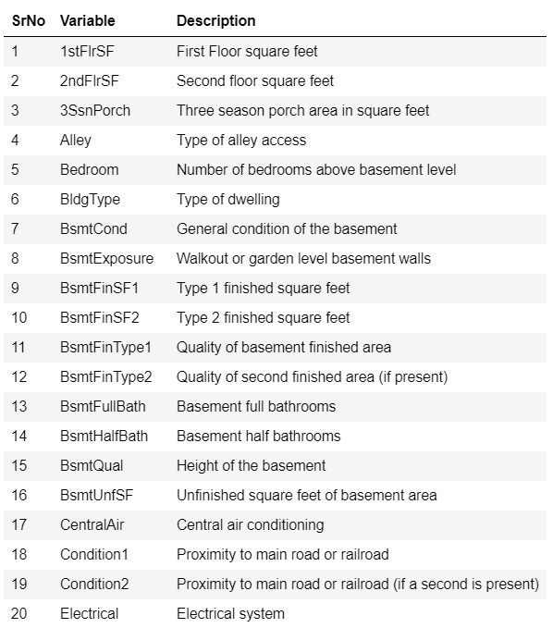
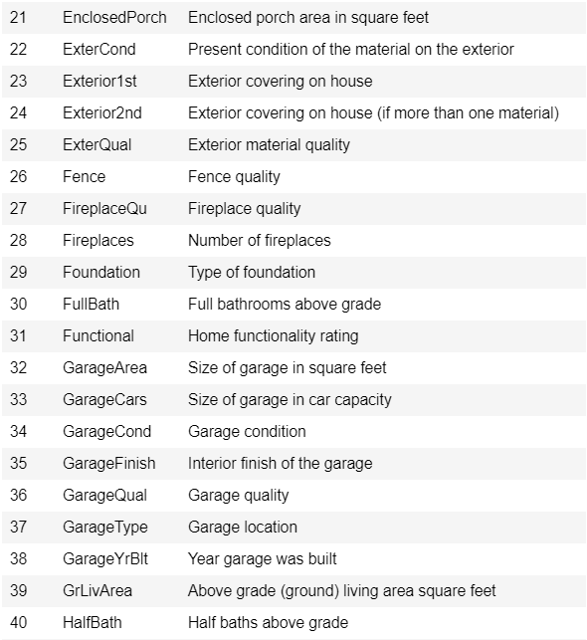
Data Information Available

Slide 5
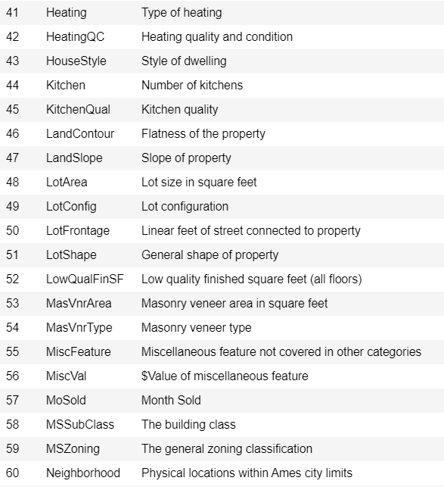
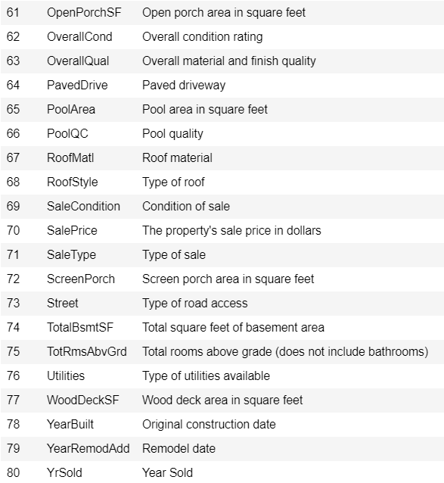

Data Information Available

Slide 6
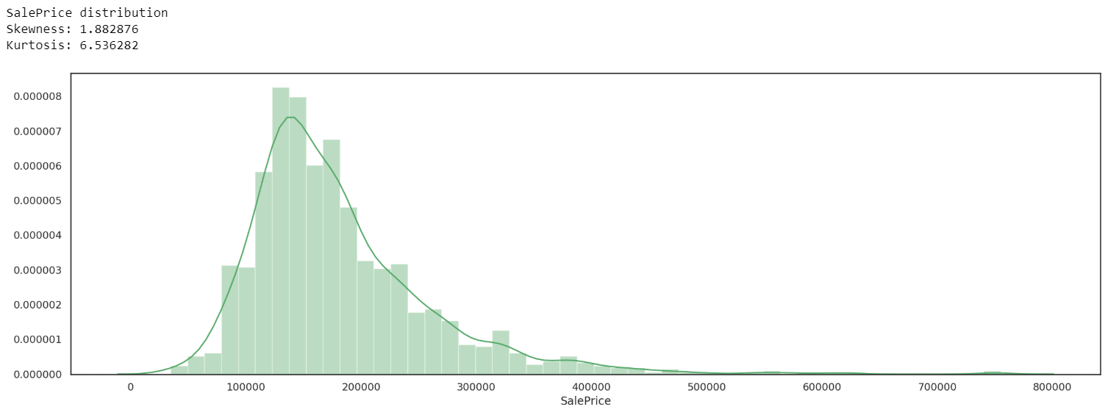
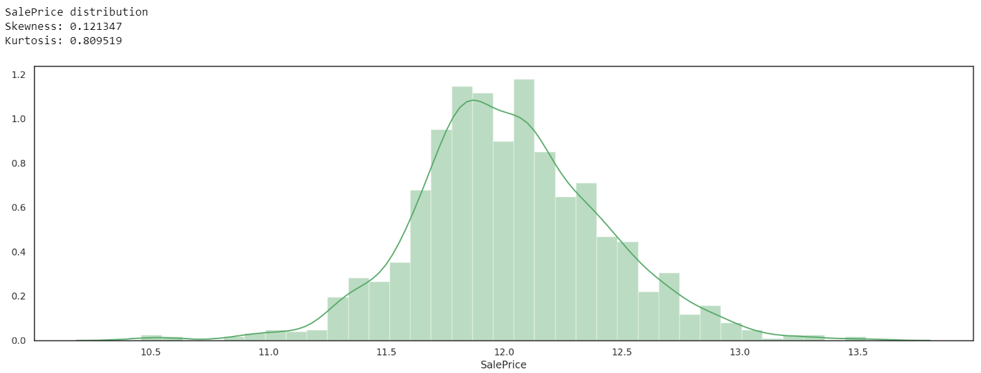
EDA: Target Variable
np.log1p(Data[‘y’])

Slide 7
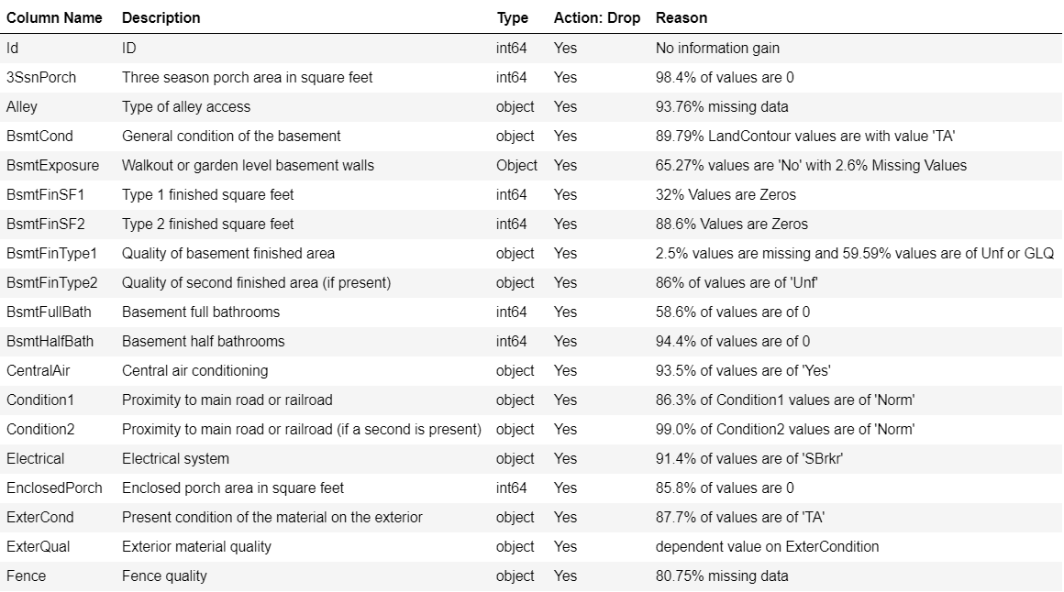
EDA: Pandas Profiling – Drop Variables

Slide 8
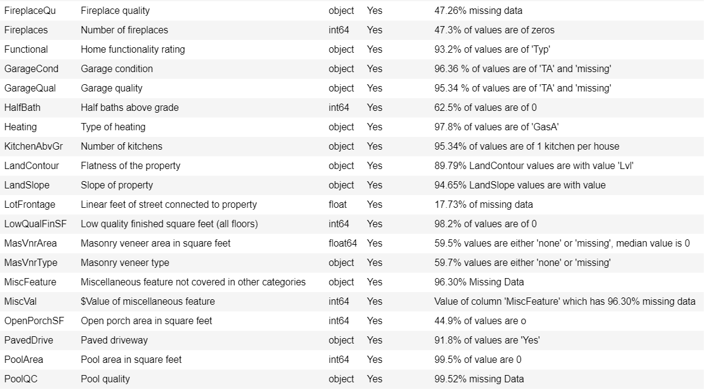
EDA: Pandas Profiling – Drop Variables

Slide 9
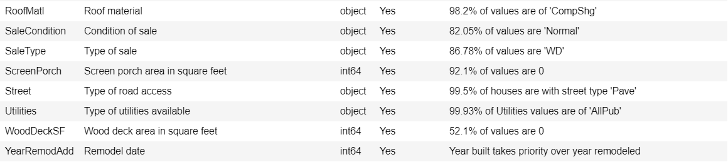
EDA: Pandas Profiling – Drop Variables

Slide 10
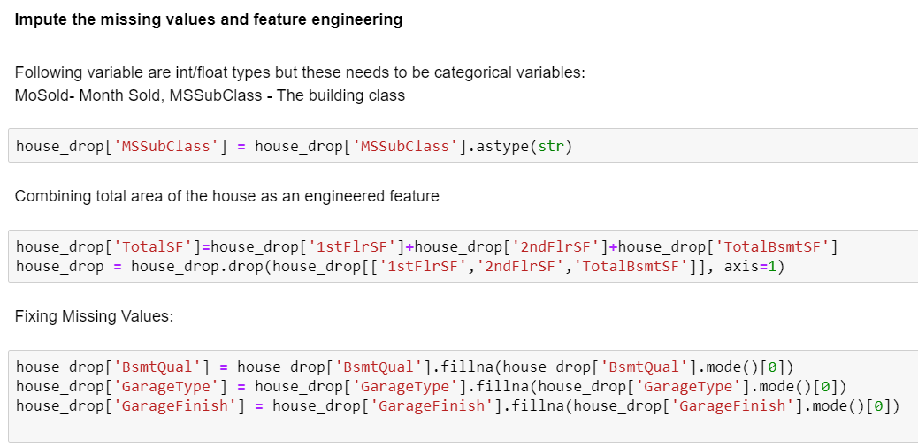
EDA: Missing Values & Feature Engineering

Slide 11
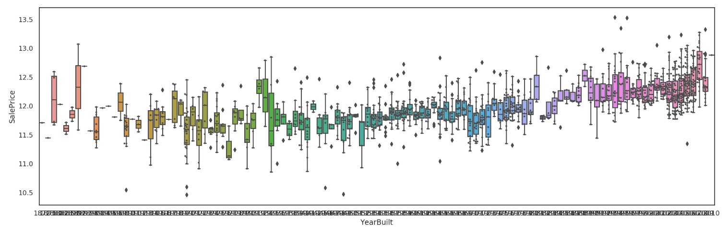
EDA: High Cardinality Check?
House Sale Price over House Build Years
Variable retained
Variable is retained since house sale price shows variation based on year in which the house is build.
Min:1872 Max:2010

Slide 12
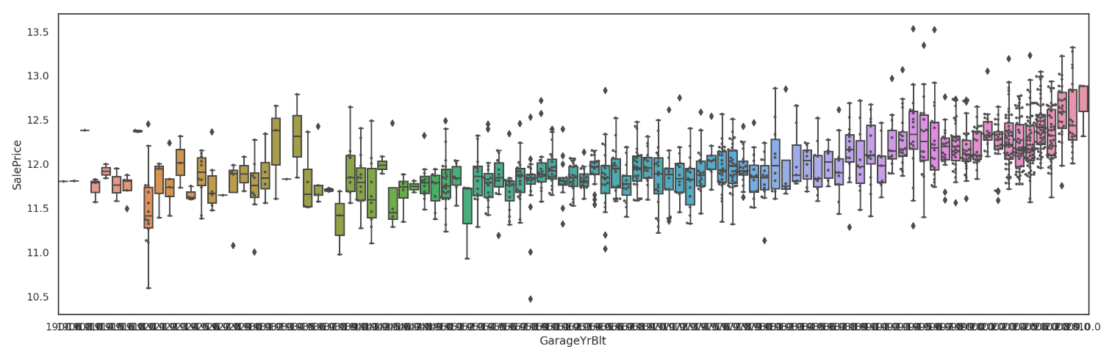
EDA: High Cardinality Check?
House Sale Price over Garage Build Years
Variable retained
Variable is retained since house sale price shows variation based on year in which the garage of the house is build.
Min:1900 Max:2010

Slide 13
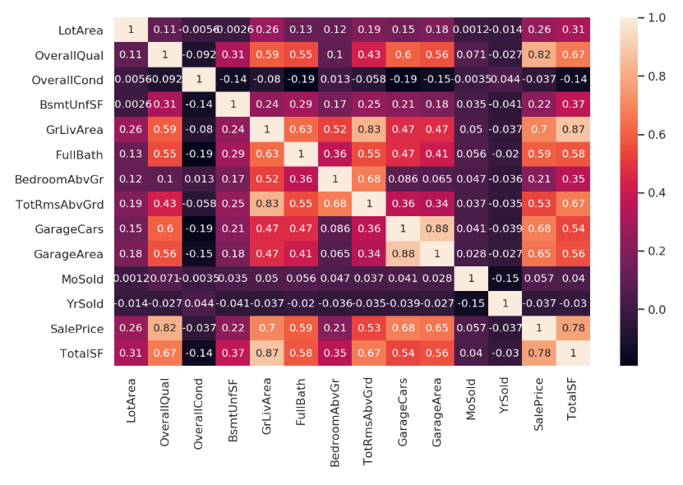

EDA: Multicollinearity Check?
Following variables are dropped because of the higher correlation
(-0.8> corr()<0.8) with other variables in the data set.
‘GarageArea’
‘GrLivArea’
'TotRmsAbvGrd'

Slide 14
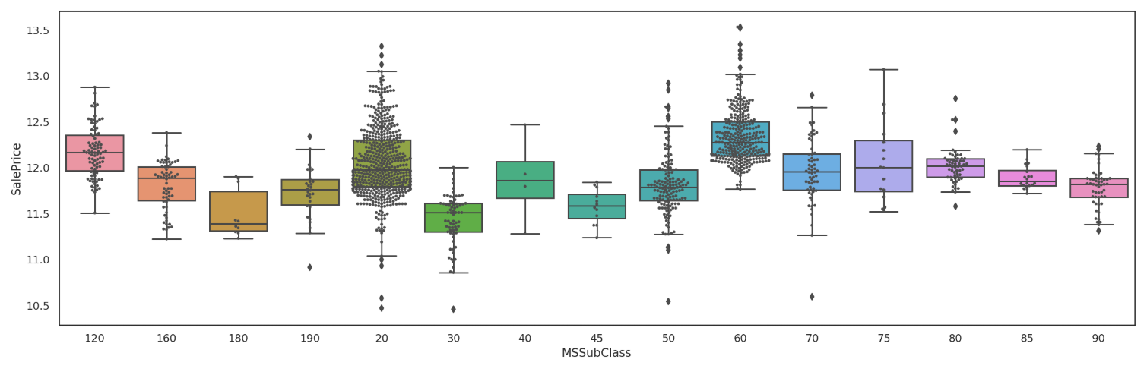
EDA: Assess Independent Variables
MSSubClass vs Sale Price
Variable retained

Slide 15
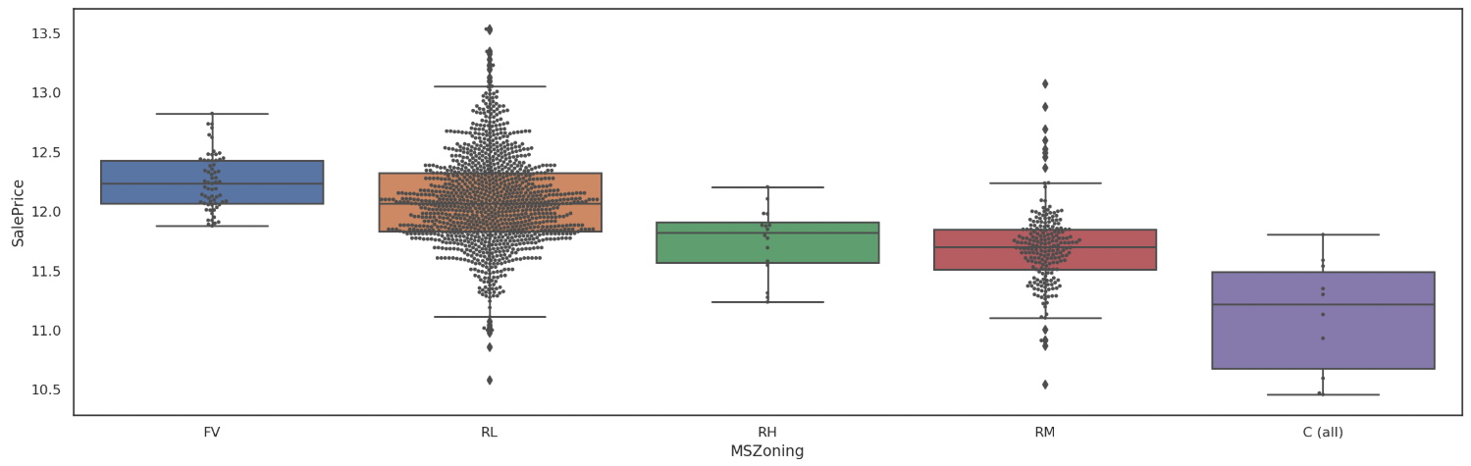
EDA: Assess Independent Variables
MSZoning vs Sale Price
Variable retained

Slide 16
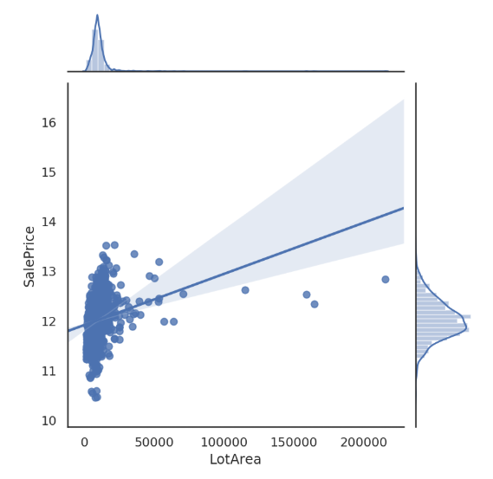
EDA: Assess Independent Variables
LotArea vs Sale Price
Variable retained
0.26 correlation with house SalePrice

Slide 17
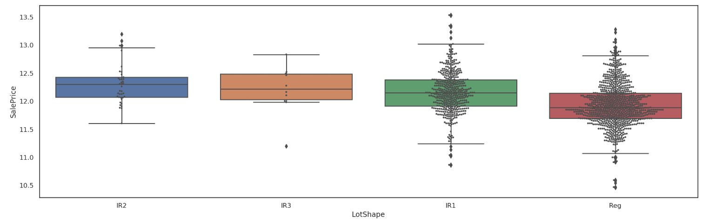
EDA: Assess Independent Variables
LotShape vs Sale Price
Variable retained

Slide 18
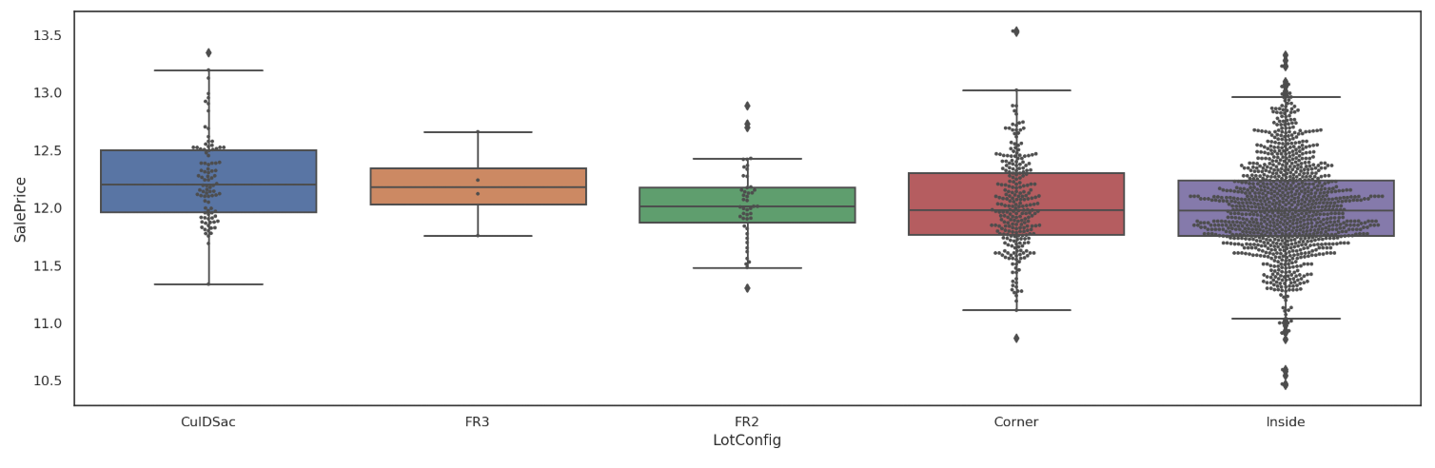
EDA: Assess Independent Variables
LotConfig vs Sale Price
Variable retained

Slide 19
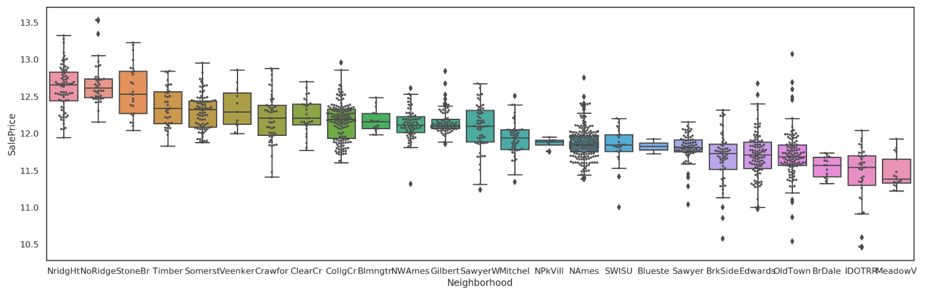
EDA: Assess Independent Variables
Neighborhood vs Sale Price
Variable retained

Slide 20
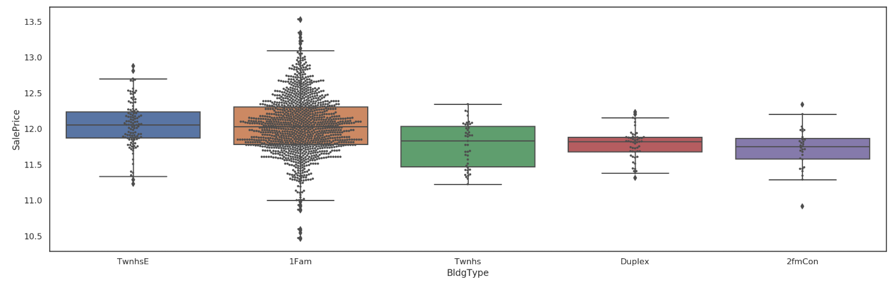
EDA: Assess Independent Variables
BldgType vs Sale Price
Variable retained

Slide 21
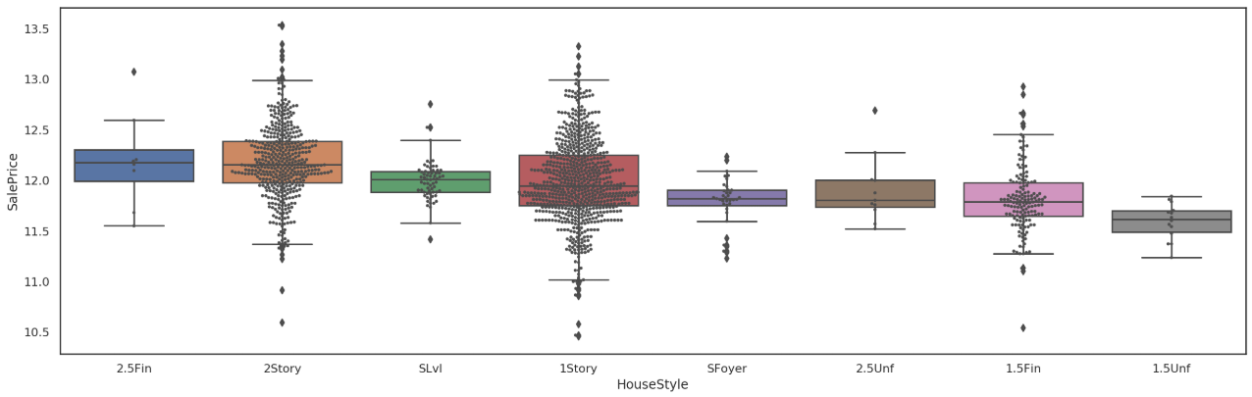
EDA: Assess Independent Variables
HouseStyle vs Sale Price
Variable retained

Slide 22
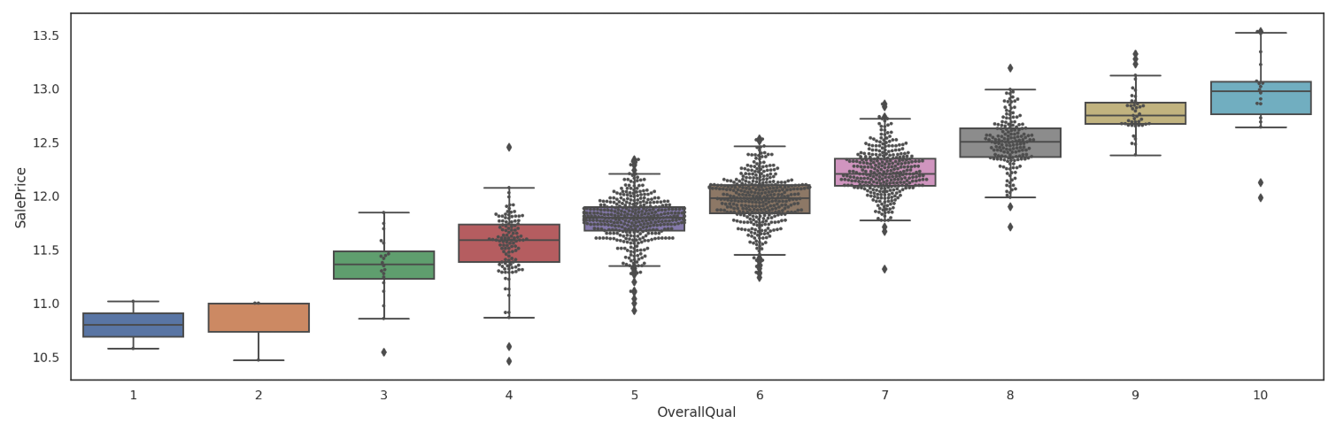
EDA: Assess Independent Variables
OverallQual vs Sale Price
Variable retained

Slide 23
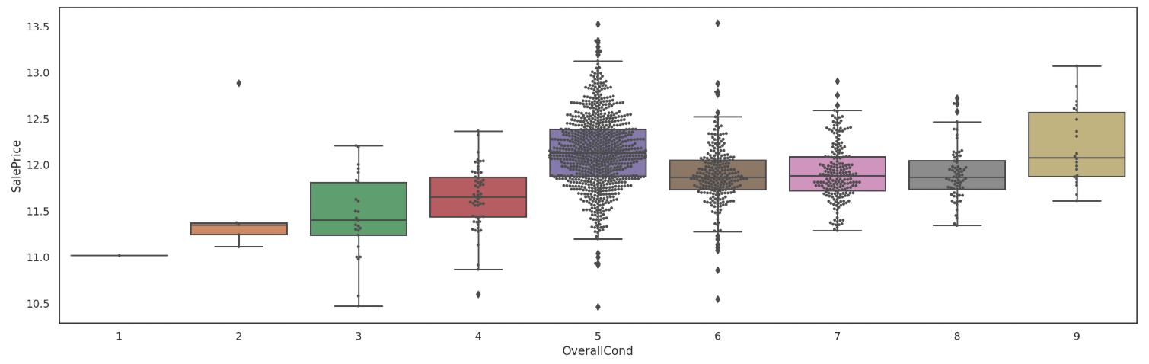
EDA: Assess Independent Variables
OverallCond vs Sale Price
Variable retained

Slide 24
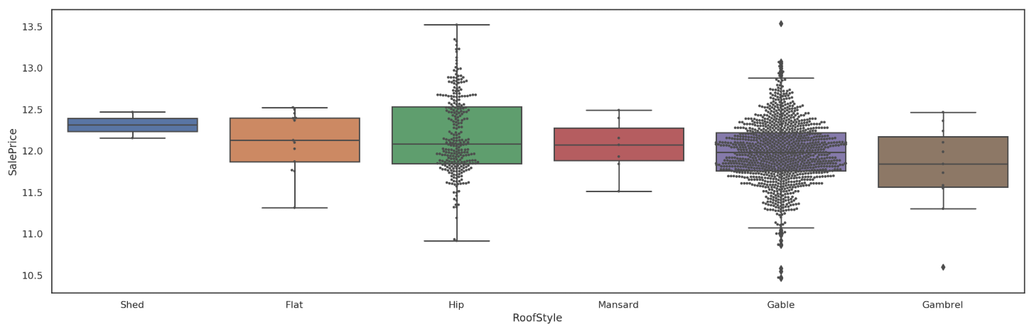
EDA: Assess Independent Variables
RoofStyle vs Sale Price
Variable retained

Slide 25
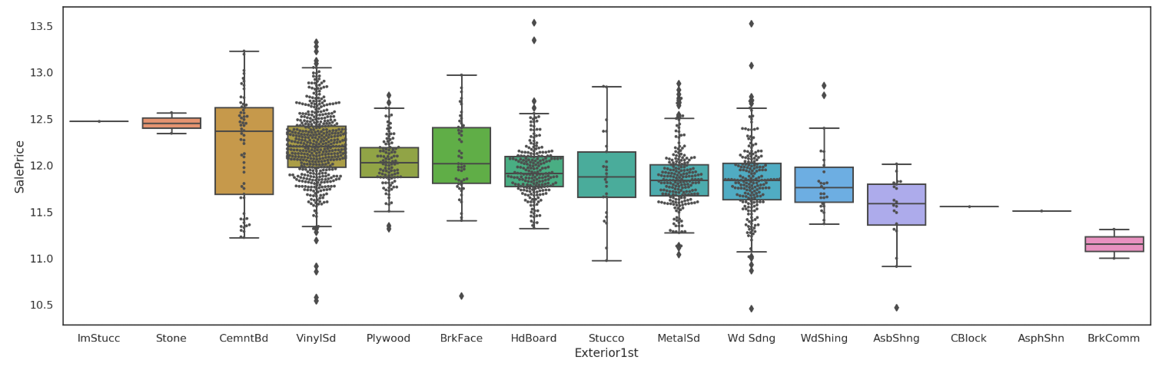
EDA: Assess Independent Variables
Exterior1st vs Sale Price
Variable retained

Slide 26
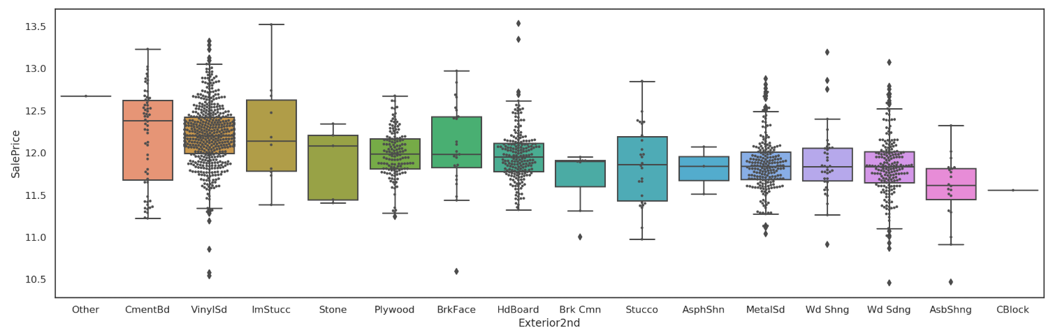
EDA: Assess Independent Variables
Exterior2nd vs Sale Price
Variable retained

Slide 27
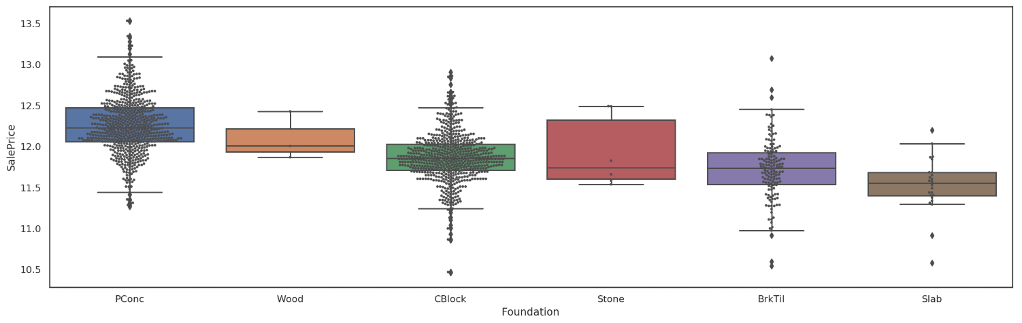
EDA: Assess Independent Variables
Foundation vs Sale Price
Variable retained

Slide 28
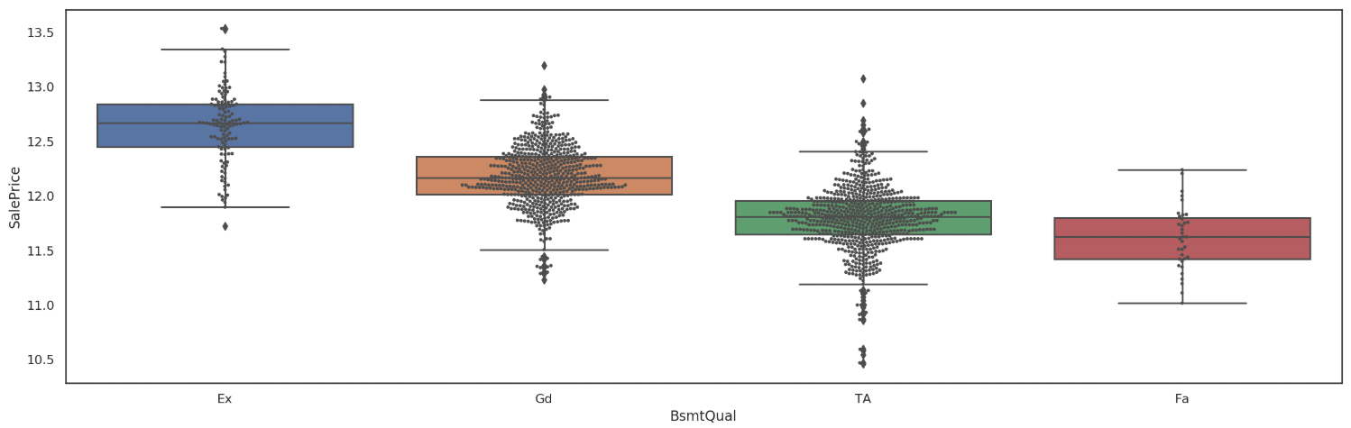
EDA: Assess Independent Variables
BsmtQual vs Sale Price
Variable retained

Slide 29
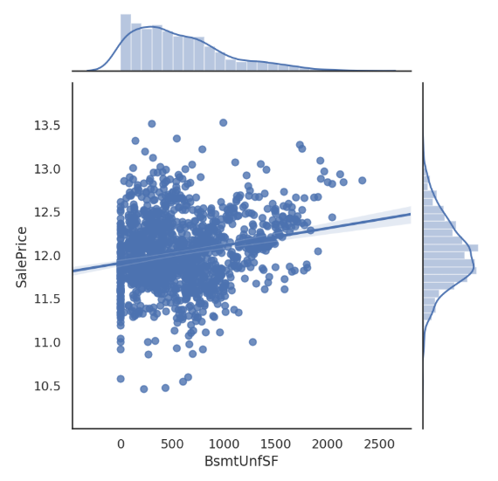
EDA: Assess Independent Variables
BsmtUnSF vs Sale Price
Variable retained
0.22 correlation with house SalePrice

Slide 30
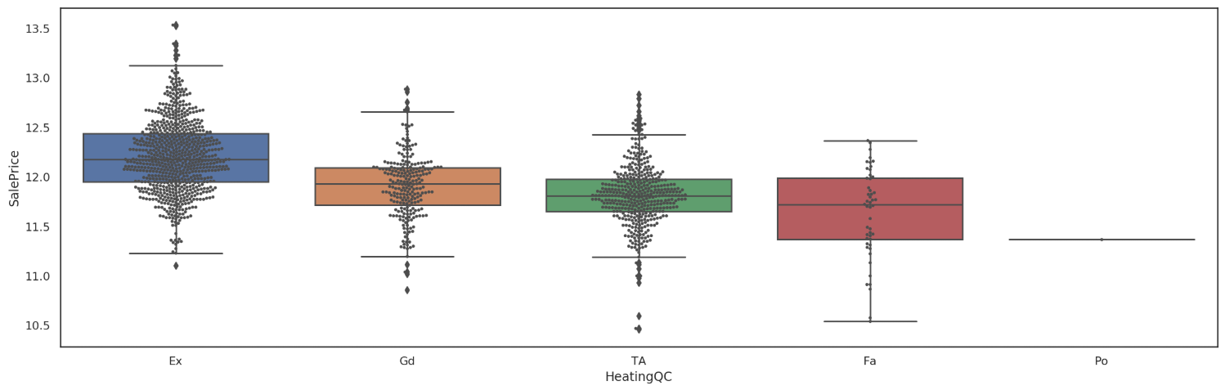
EDA: Assess Independent Variables
HeatingQC vs Sale Price
Variable retained

Slide 31
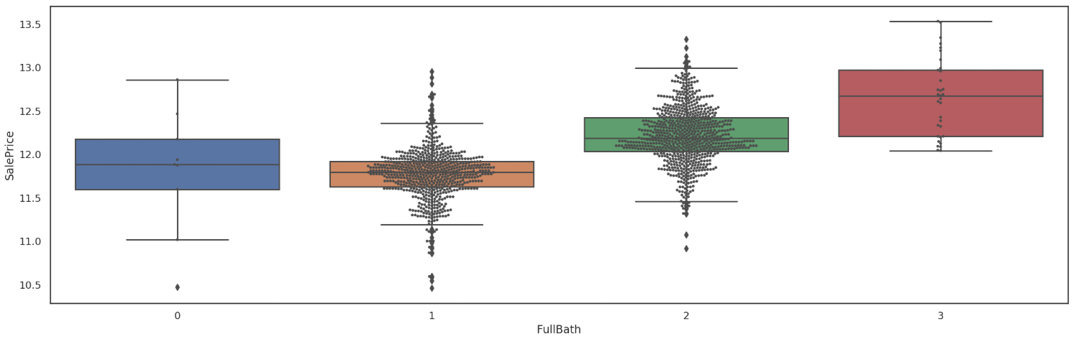
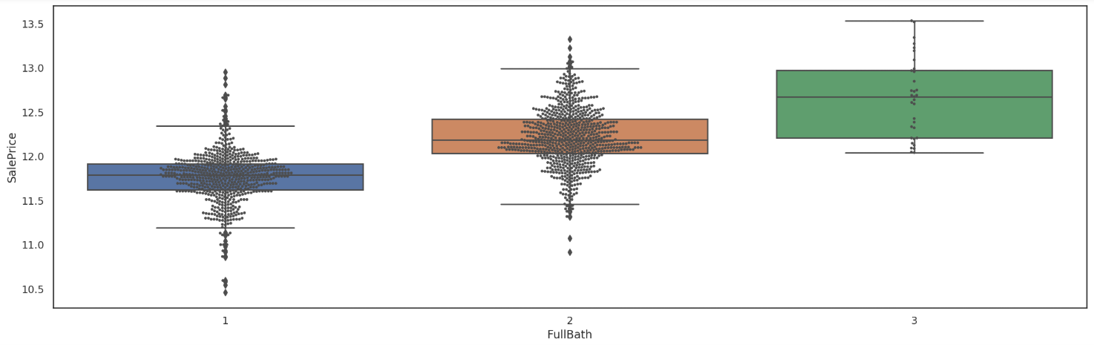
EDA: Assess Independent Variables
Full Bath vs Sale Price
Variable retained

Slide 32
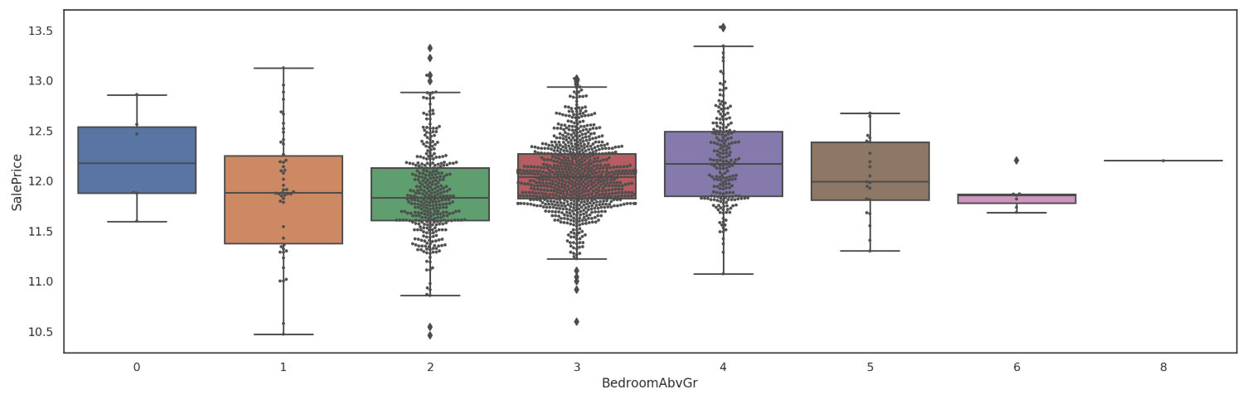
EDA: Assess Independent Variables
BedroomAbvGr vs Sale Price
Variable retained

Slide 33
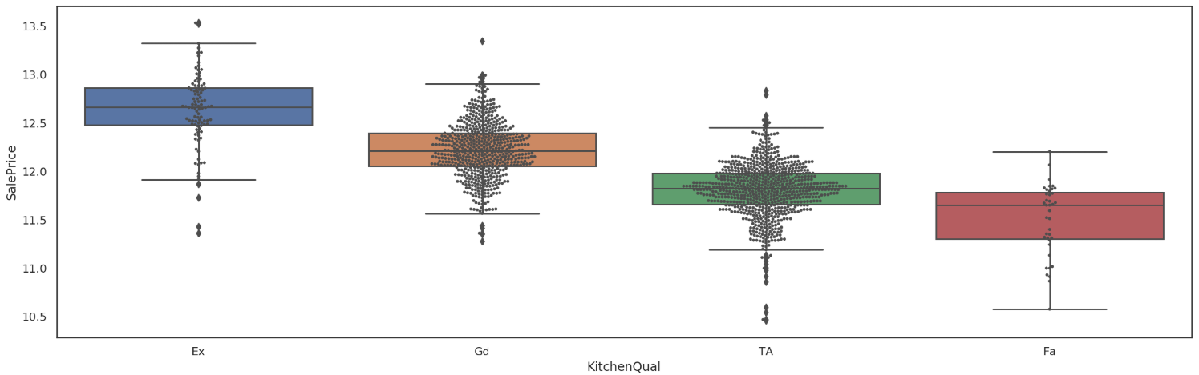
EDA: Assess Independent Variables
KitchenQual vs Sale Price
Variable retained

Slide 34
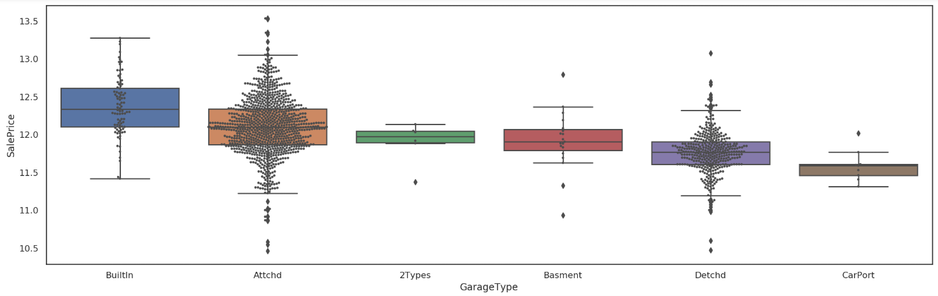
EDA: Assess Independent Variables
GarageType vs Sale Price
Variable retained

Slide 35
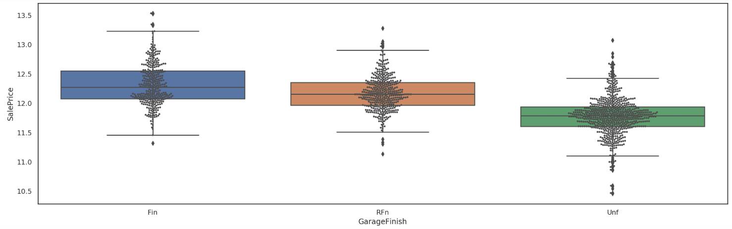
EDA: Assess Independent Variables
GarageFinish vs Sale Price
Variable retained

Slide 36
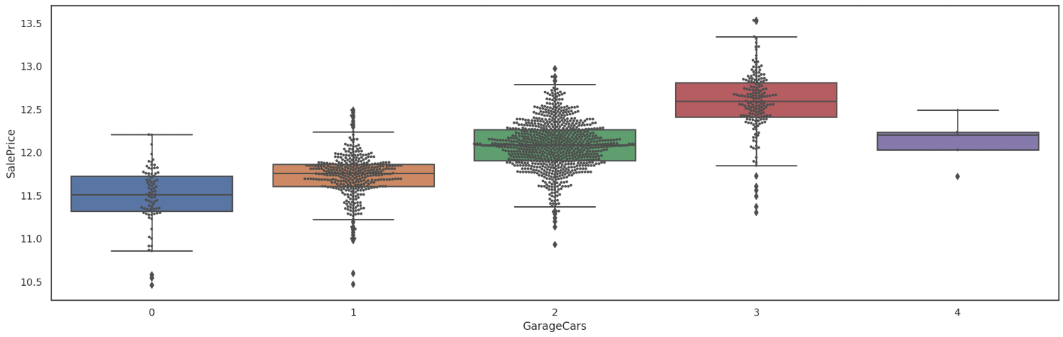
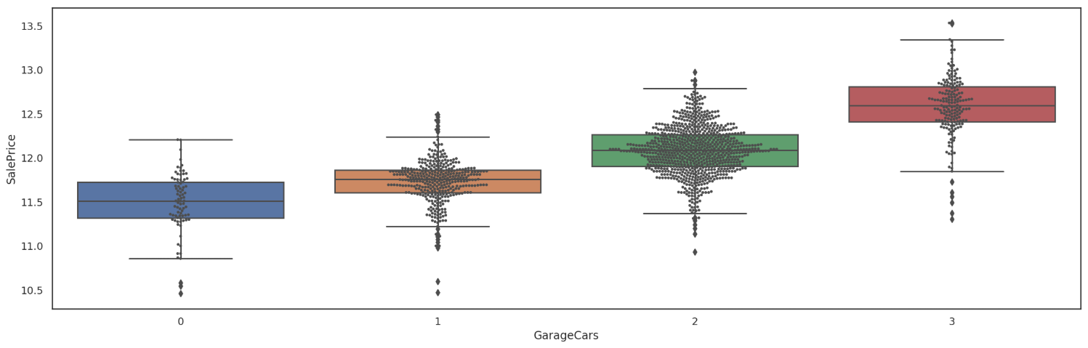
EDA: Assess Independent Variables
GarageCars vs Sale Price
Variable retained

Slide 37
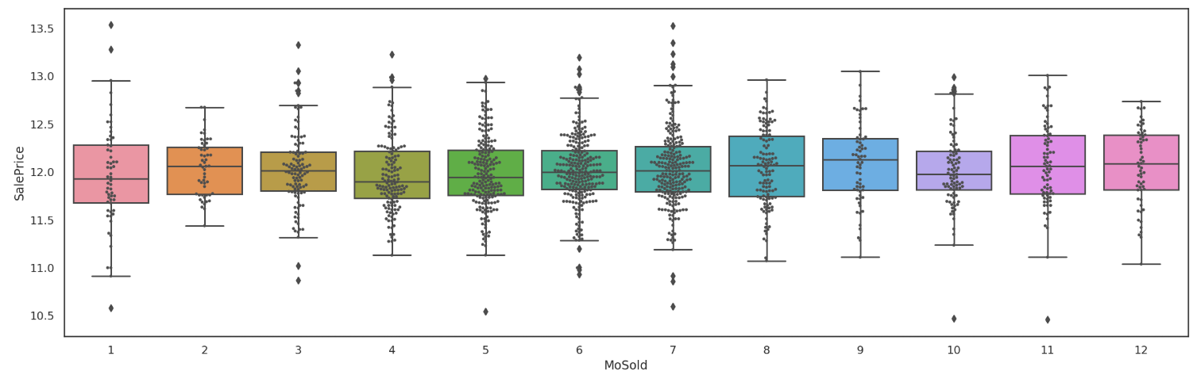
EDA: Assess Independent Variables
MoSold vs Sale Price
Variable retained

Slide 38
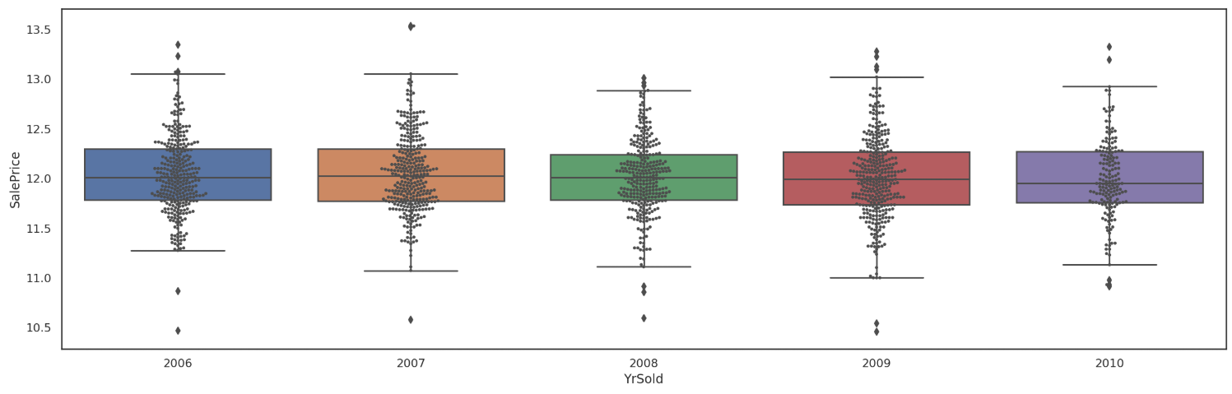
EDA: Assess Independent Variables
YrSold vs Sale Price
Variable retained

Slide 39
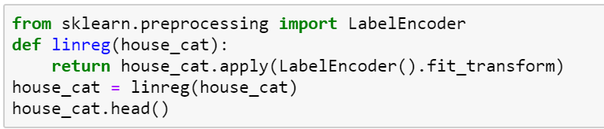
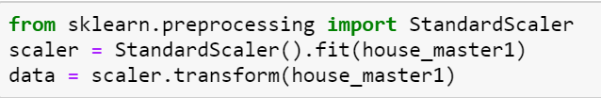
Preprocessing Data
Label Encoding – Label encoder used to convert categorical values into numerical numbers
Scalling – Standard Scaler is used to scale data
Test_Train_Split – Data is splitted into 25:75 ratio to create train and test datasets

Slide 40
Models Used
LINEAR REGRESSION MODEL
DECISION TREE REGRESSOR MODEL
RANDOM FOREST REGRESSOR MODEL

Slide 41
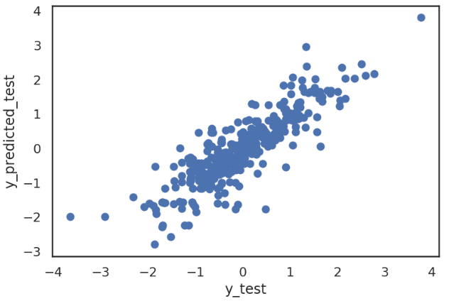
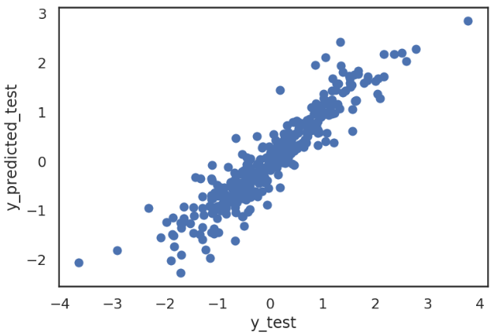
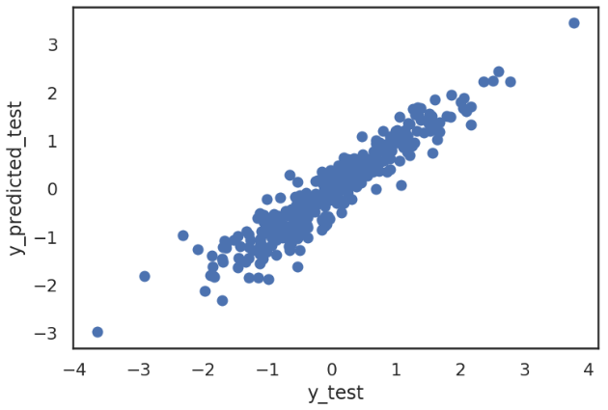
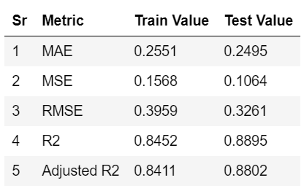
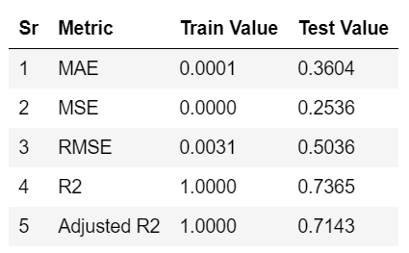
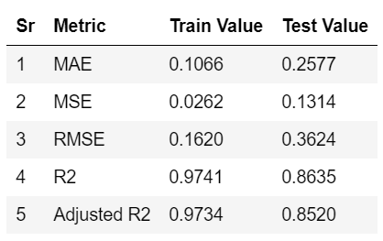
Conclusion
LINEAR REGRESSION MODEL
DECISION TREE REGRESSOR MODEL
RANDOM FOREST REGRESSOR MODEL

Slide 42
Recommendations
RMSE score (lower) and Adjusted R2 score (higher) both are better in case of Linear Regression model compare to Decision Tree and Random Forest models in this specific use case. Linear Regression is the best model among the other models used in this assessment to predict house sale price.

Slide 43
Thank You
SANKET PADWAL

